Slide 1
Design Pattern – Adapter Pattern
December, 2016

Slide 2
Introduction
Implementation
UML Diagram
Java API

Slide 3
Introduction
Adapter design pattern in Java, also known as the Wrapper pattern is another very useful GOF pattern, which helps to bridge the gap between two classes in Java.
As the name suggest, Adapter allows two classes of a different interface to work together, without changing any code on either side.
Adapters are everywhere in real life, most commonly when we talk about Adapter, we mean electrical adapters. In US, UK or any other Europian or North American country, you might have seen different kinds of electrical socket than in India e.g. USA has a rectangular socket, as compared to cylindrical one from India.
Adapter design pattern makes incompatible interfaces work together, without changing them. Only new code which is inserted is in the form of Adapter or Wrapper class.

Slide 4
Implementation
There are two ways to implement Adapter design pattern in Java
Using Inheritance also known as Class Adapter pattern
Using Composition, better known as Object Adapter pattern.
In both cases, it's better to declare client interacting public methods in an interface, you may call it target interface.
Now your Class Adapter pattern extends the original interface, which is incompatible to the client but provides the functionality needed by the client, and it also implements the target interface. Now, Adapter implements target method in such a way that it delegates actual work on original class, which Adapter get access by extending it.
Similarly, in the case of Object Adapter pattern, which uses Composition for reusing code, it also implements target interface and uses object of the Original incompatible class to do all of its work. Since it’s better to prefer composition over inheritance, I advise that you should stick with Object Adapter pattern.

Slide 5
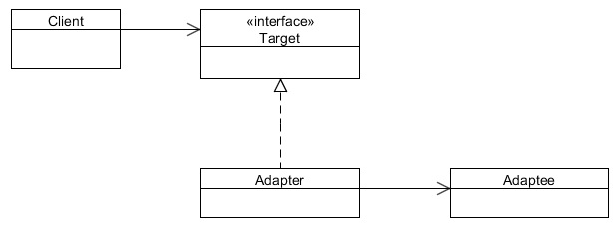
UML Diagram
Target - defines the domain-specific interface that Client uses.
Adapter - adapts the interface Adaptee to the Target interface.
Adaptee - defines an existing interface that needs adapting.
Client - collaborates with objects conforming to the Target interface.

Slide 6
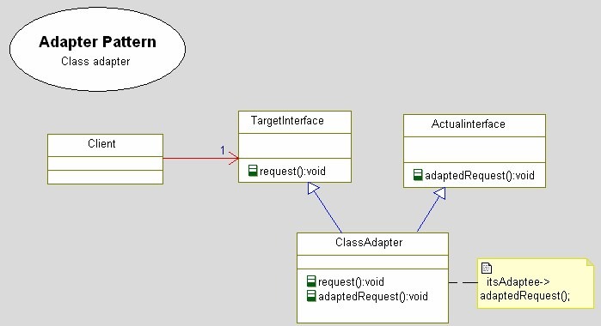

Slide 7
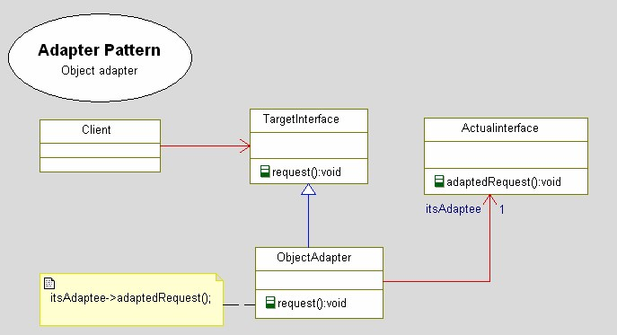

Slide 8
Java API
Structural patterns
Adapter (recognizeable by creational methods taking an instance of different abstract/interface type and returning an implementation of own/another abstract/interface type which decorates/overrides the given instance)
• java.util.Arrays#asList()
• java.util.Collections#list()
• java.util.Collections#enumeration()
• java.io.InputStreamReader(InputStream) (returns a Reader)
• java.io.OutputStreamWriter(OutputStream) (returns a Writer)
• javax.xml.bind.annotation.adapters.XmlAdapter#marshal() and #unmarshal()

Slide 9
API Example
public static <T> Enumeration<T> enumeration(final Collection<T> c) {
return new Enumeration<T>() {
private final Iterator<T> i = c.iterator();
public boolean hasMoreElements() {
return i.hasNext();
}
public T nextElement() {
return i.next();
}
};
}

Slide 10
THANK YOU

